Slide 1


Expense Management System
Your Money, Managed Wisely

Slide 2
Team Members
Team Leader- Abhay kothwade
UI/Designer-Vikas Bhonde
Backend Developer-Abhay kothwade
Frontend developer-Mughesh B

Slide 3
Features
1. User-friendly Dashboard for expense tracking.
2. Interactive cards for Total Expenses, Savings, and Budget.
3. Secure Login and Registration functionality.
4. Budget Planning and Analytics.
5. Responsive design for all devices.

Slide 4
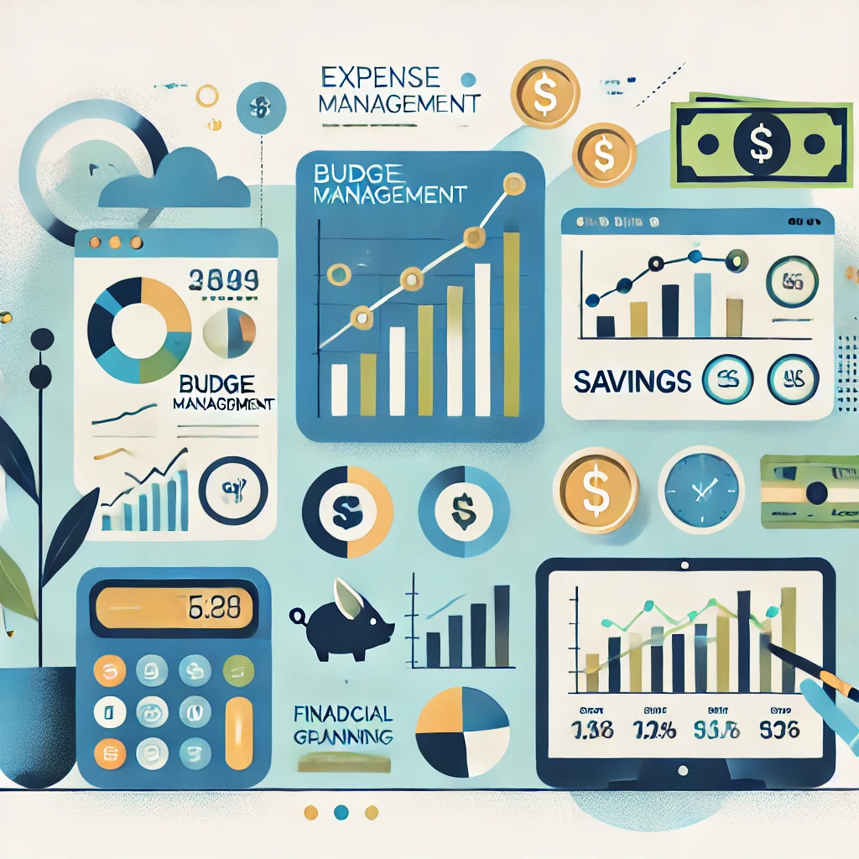
Key Modules
1. User Authentication and Registration
2. Expense Tracking: Add, edit, and delete expenses.
3. Budget Management: Set and track monthly budgets.
4. Savings Overview: Visualize savings to plan for the future.
5. Notifications: Alerts for exceeding budgets.
6. Dashboard: Centralized financial summary.

Slide 5
Technology Used
Frontend: React.js
Backend: Spring Boot
Database: MongoDB
Other Tools: CSS for styling, Axios for API requests

Slide 6
System Workflow
For Users:
1. Register/Login securely.
2. Add expenses with categories.
3. Set budgets and monitor financial health.
4. Access detailed analytics on the dashboard.
For Admins:
1. Manage users and expenses.
2. Ensure data security and system efficiency.

Slide 7
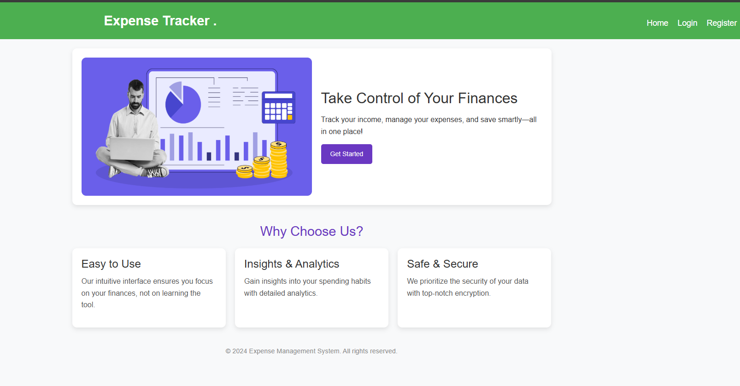

Slide 8
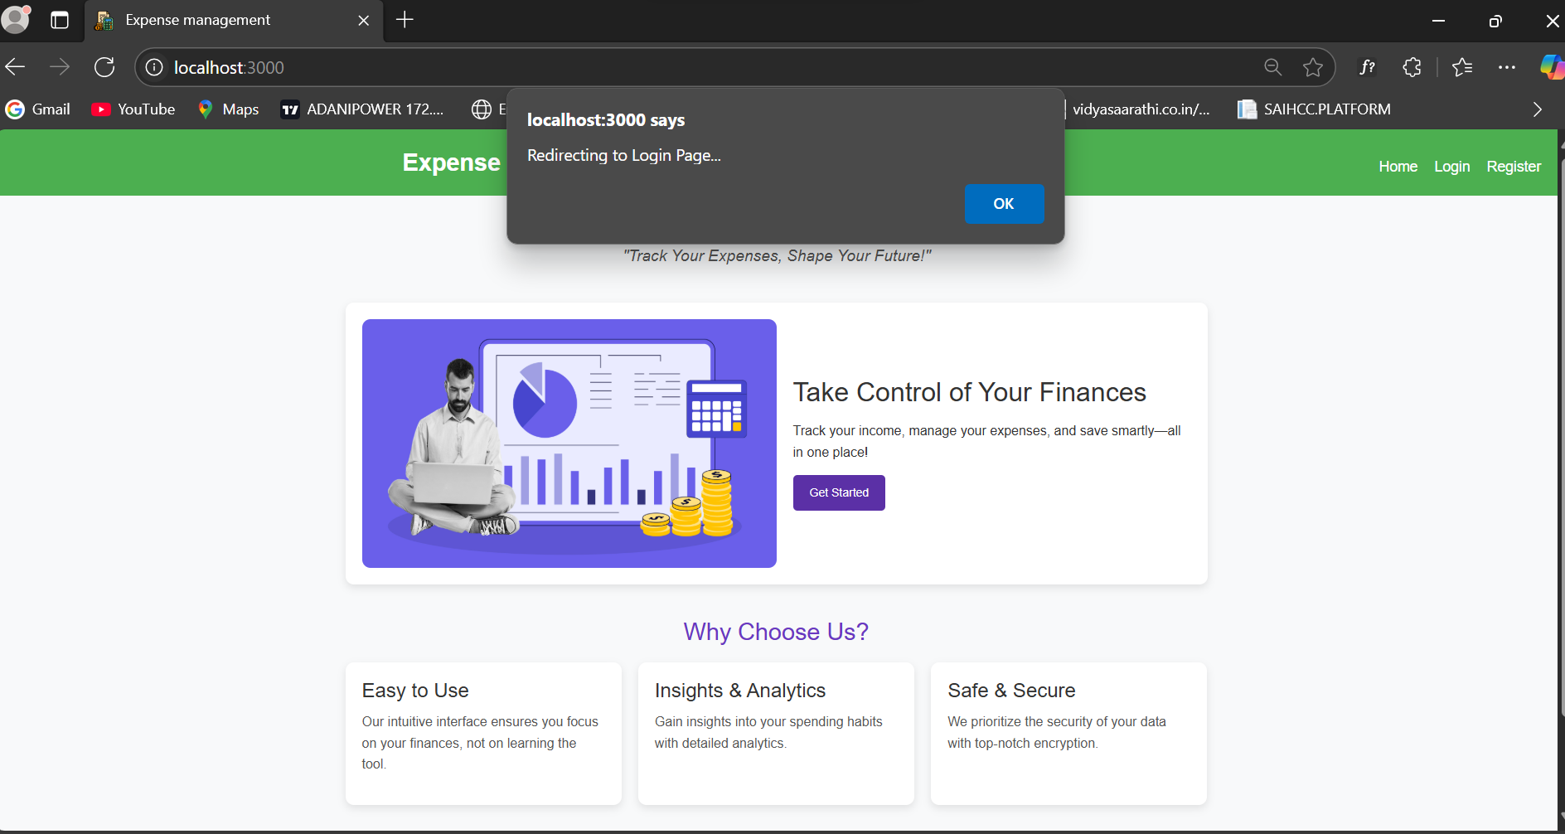

Slide 9
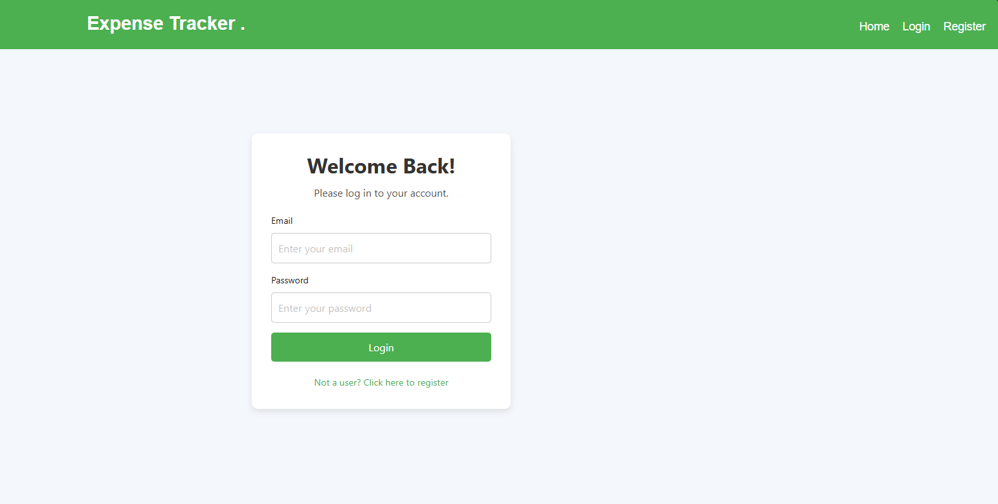
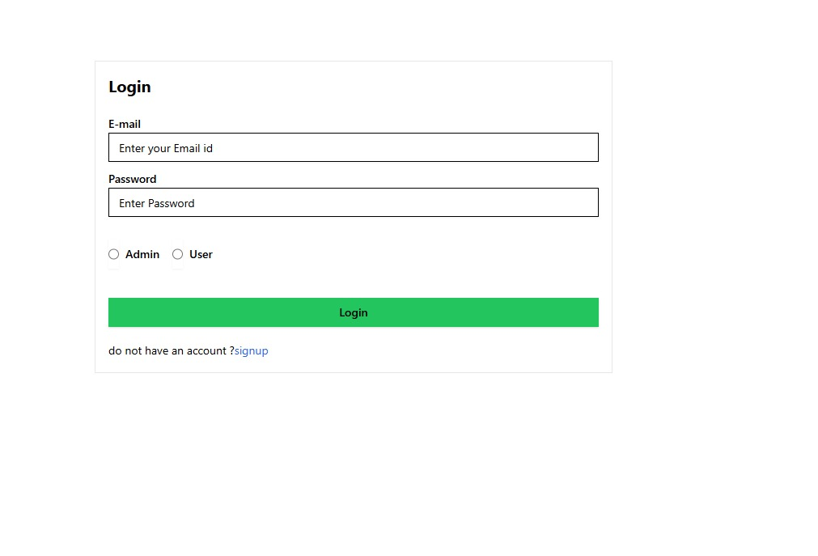

Slide 10
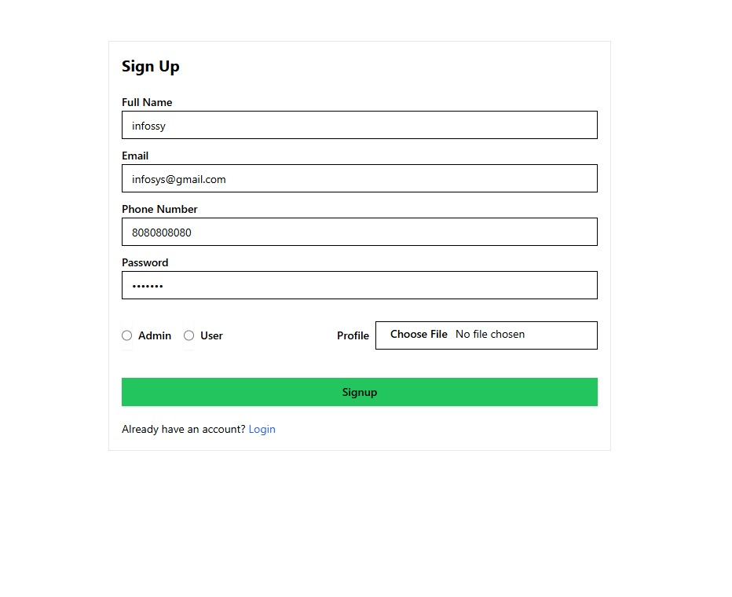
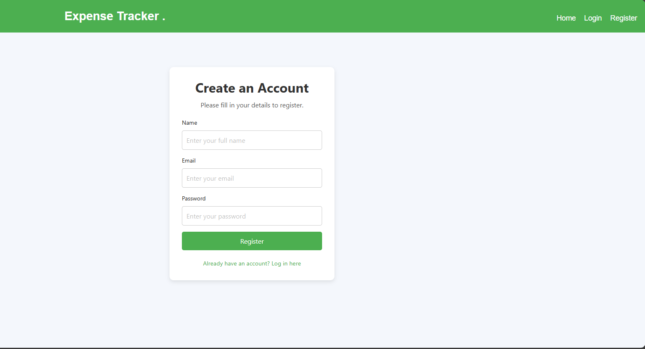

Slide 11
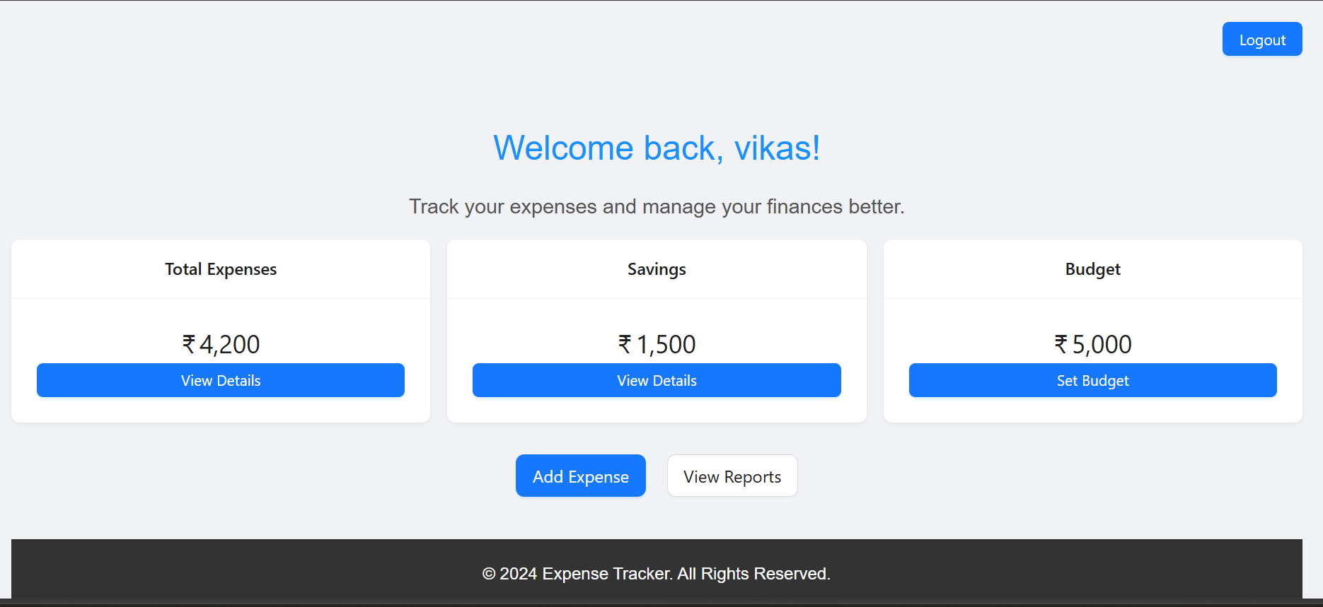

Slide 12
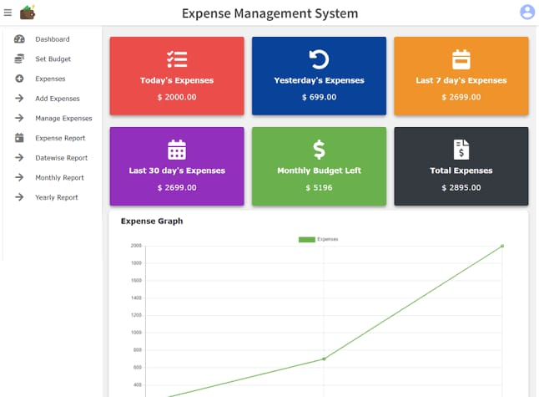

Slide 13
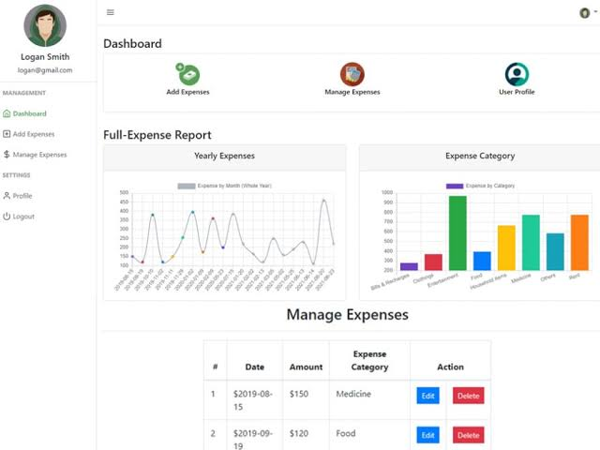

Slide 14
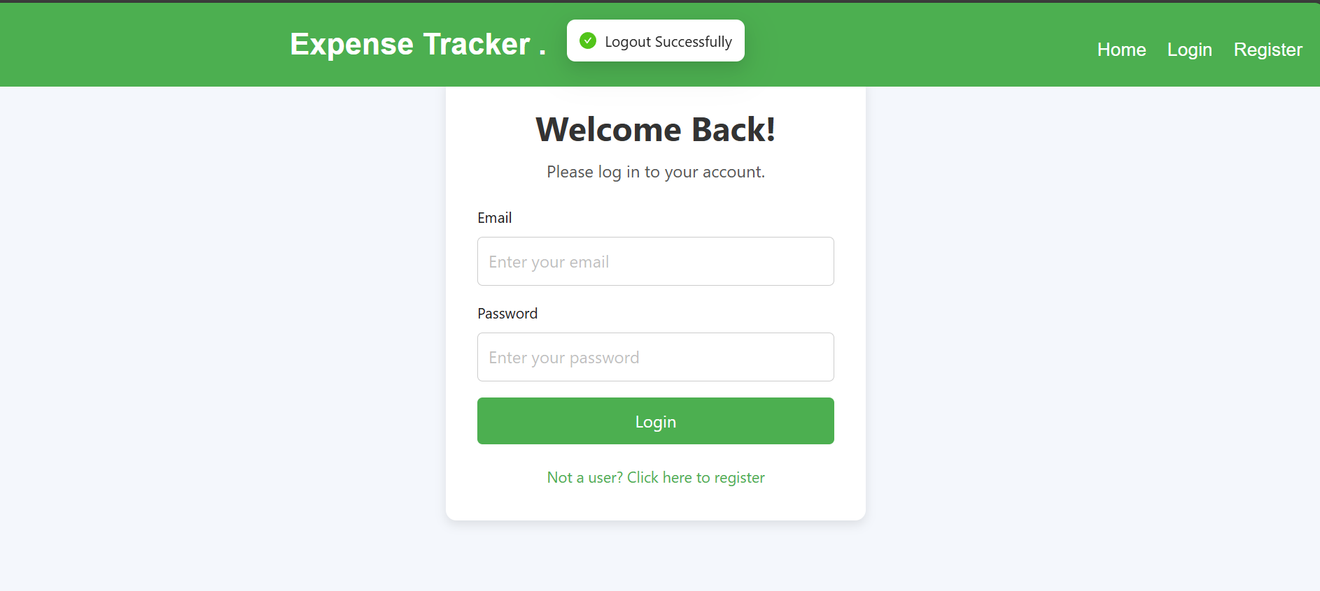

Slide 15
Benefits of the System
1. Simplified Financial Tracking: Helps users track and categorize their expenses effortlessly.
2. Improved Budget Management: Users can set realistic budgets and monitor them.
3. Visual Insights: Analytics provide an overview of financial health.
4. Accessibility: Fully responsive and available on all devices.

Slide 16
Challenges and Learning
Challenges:
1. Ensuring a seamless user experience.
2. Managing data efficiently across the backend.
Learning Outcomes:
1. Mastery of React hooks like useState and useEffect.
2. Implementing secure user authentication.
3. Responsive design principles.

Slide 17
Future Scope
1. Expense Trends Analysis: Graphs to visualize spending patterns.
2. Multi-User Collaboration: Shared expense tracking for families or teams.
3. Advanced Notifications: Alerts for upcoming bills and savings goals.

Slide 18
Conclusion
1. Simplified expense tracking and budget management.
2. Helps users make informed financial decisions effortlessly.
3. Benefits both personal users and teams with enhanced financial planning.

Slide 19
Thank You
Questions and feedback are welcome!

